Slide 1
Azure Virtual Machines

Slide 2
Topics
Introduction
Provisioning VMs
Scalability & Reliability
Networking
Additional Concepts
Notes:
Objective: Discuss the agenda for the deck
Notes:
The deck is broken into 5 key sections that discuss:
General introduction to Azure VM’s
Process involved and options for provisioning a VM
Concepts and tooling related to scalability and reliability in Azure VMs
Networking infrastructure for use with Azure VMs
Additional concepts or solutions that build on Azure VM’s

Slide 3
Azure Virtual Machine Benefits
Choice
Choose from thousands of pre-configured VM images or configure, capture, and upload your own custom images
Leverage VM Extensions to do custom post-deployment configuration
Scalability & Reliability
Select system profiles to best match your workload
Configure drives for size and performance
Leverage VM Scale Sets to scale from one to thousands of VM instances
Access & Security
Configure Azure networking to the topology you require
Extend your on-premises infrastructure into the Cloud
Notes:
Objective: Introduce the advantages of VM offerings on the Azure Platform
Notes:
There are 3 key areas where Azure VM’s offer a significant advantage:
Choice – Users can choose from a frequently-updated gallery of pre-configured VM images, or they can prepare and upload their own (and what they upload can either be an image – multiple VM’s get made from images – or a ready-to-run VM. On top of all that, VM Extensions can be used to run post-configuration setup steps.
Scalability/Reliability – Users can choose VM configurations (CPU, RAM, HDD, etc) that matches their workloads. They can also configure attached storage as needed (and as the chosen VM tier permits), and then use VM Scale Sets to horizontally scale their images across multiple VM instances.
Access/Security – Users can configure Azure networking to isolate their VM’s within the Azure network, and even extend that network topology to connect to their on-premises network or to other Azure networks.

Slide 4
Provisioning a VM
Notes:
Objective: This section will discuss the steps involved in and key options for provisioning VMs in Azure.

Slide 5
Provisioning Steps
Image
Select an image from the VM Gallery
Upload your own Custom-Prepped Image
Scale
General Purpose
Compute Optimized
Memory Optimized
GPU
Boot
Create new disk in Storage
Boot the machine
High Performance Compute
Use a Custom ARM Template
Easy as 1-2-3!
Notes:
Objective: To illustrate typical straightforward processes for provisioning VMs
Notes:
The process of provisioning a VM usually follows 3 basic steps:
Choose the VM Image, either from a pre-existing gallery of images, by preparing and uploading your own image, or via an ARM template (which references either a pre-existing image or one you uploaded)
Choose the size and performance characteristics for your VM, depending on its intended purpose (general, compute-heavy, memory-intensive, requiring GPU processing, or HPC.)
Boot the VM instance – generate a new VM disk instance in storage, then boot the machine.

Slide 6

















VM Gallery Images
Windows Server 2012 R2
Ubuntu Server 14.04 LTS
CentOS 6.5
SUSE Linux
Enterprise Server
openSUSE 13.1
Oracle Linux 6.4.0.0.0
SQL Server 2014 Standard
Oracle Database 11g R2
SharePoint Server Farm
Microsoft Dynamics
GP 2013
Zulu 8
BizTalk Server 2013
SAP HANA
Developer Edition
Puppet Enterprise 3.2.3
Barracuda Web Application
Oracle WebLogic
Server 12.1.2
Visual Studio Ultimate 2013
Windows 8.1 Enterprise
Notes:
Objective: To illustrate a sampling of the array of different kinds of VM images available in the VM Gallery.
Notes:
One of the ways a VM can be provisioned is by selecting a predefined image from the VM Gallery, which offers a wide variety of vendor/partner-provided pre-configured VM images that you can choose from.
Examples include
Windows Server versions/editions or Linux Servers
SQL Server database or Oracle database
MSDN subscribers also get access to Windows images pre-populated with Visual Studio and Windows Client OS versions for use in DevTest scenarios

Slide 7
Microsoft Linux
Notes:
Objective: To help foster the perception change about the “old” and “new” Microsoft, illustrating “open and inclusive”.
Notes:
Just because Azure comes from Microsoft doesn't mean it's Windows-centric. Azure loves Linux, and much of the ongoing development taking place in Azure today is designed to make it the best cloud platform in the world for hosting Linux and popular open-source tools that run on it.
In fact > 30% (and growing) of VM’s in Azure today run Linux

Slide 8

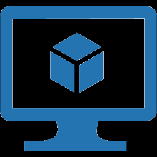

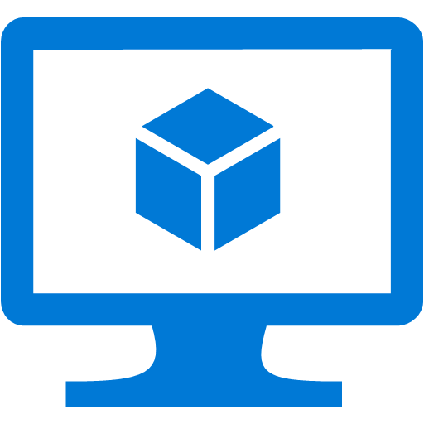
Custom Image Upload
Prepare the VHD
Optional – generalize the VHD by using SysPrep/waagent
Upload the VHD to Azure Storage
Prepare networking resources
Create the VM from uploaded generalized or specialized image
On-Premises
Cloud
VHD
Notes:
Objective: To show another option for deploying VM’s – via uploading a custom image.
Notes:
One unique thing about Azure is its Hybrid nature – VM exchange isn’t strictly uni-directional, VHD’s can be moved from Azure to on-prem.
A “generalized” image is one which is intended to be used to create multiple new VM’s - it has all personal information & state removed via SysPrep (Windows) or waagent (Linux)
A “specialized” image is one which is intended to be used “as is” in Azure

Slide 9
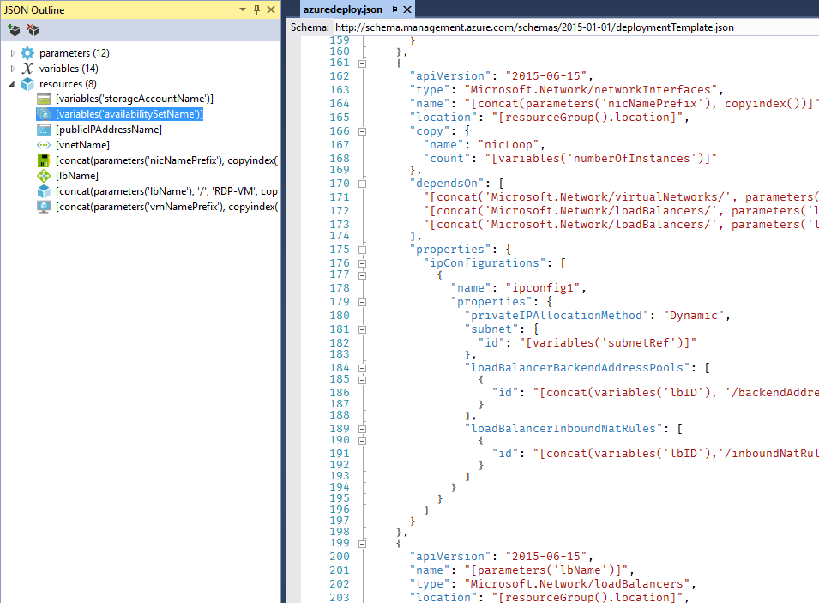
Deployment with ARM Templates
Declarative deployment
Maintain resources with the same lifecycle within a resource group
Configure parameters for input/output
Specify resources & dependencies
Leverage Quickstart Templates or export existing resources
Notes:
Objective: To show another option for deploying VM’s – via ARM templates.
Notes:
Another deployment option is to use ARM Templates
ARM Templates are declarative files that define the resources to deploy and the inter-relationships between deployed resources
Specify input parameters and variables, use expressions
Use Azure Quickstart templates, with source in GitHub
Edit in Azure online editor, use Visual Studio tooling, use Visual Studio Code
They can be checked into source control in order to simplify deployment management

Slide 10
"name": "MyUbuntuVM",
"type": "Microsoft.Compute/virtualMachines",
"apiVersion": "2015-06-15",
"location": “eastus",
"properties": {
"hardwareProfile": {
"vmSize": "Standard_D2_v2“
},
"osProfile": {
"computerName": “AzureLabVM",
"adminUsername": "azureuser",
"adminPassword": "Azure4Research“
},
"storageProfile": {
"imageReference": {
"publisher": "Canonical",
"offer": "UbuntuServer",
"sku": "16.04-LTS",
"version": "latest“
},
"osDisk": {
"name": "osdisk",
"vhd": {
"uri": "https://vmlabstorage.blob.core.windows.net/vhds/myosdisk.vhd“
},
"caching": "ReadWrite",
"createOption": "FromImage“
}
},
"networkProfile": {
"networkInterfaces": [
{
"id": "[resourceId('Microsoft.Network/networkInterfaces/myVMNic'))]“
}
]
}
}
Notes:
Objective: To show an illustration of the VM-resource section of an ARM template involved in provisioning a VM and its related resources
Notes:
This is a section of a simple (no parameters, variables) ARM template used to provision an Ubuntu VM.
Key notes include:
Key attributes of name, type, apiVersion, location, and properties
The OS profile describing the computer name, admin user, and password
The image to use and where the VHD for the VM should be stored
A NIC resource attached to the VM

Slide 11
ARM Template Format
"$schema": "https://schema.management.azure.com/schemas/2015-01-01/deploymentTemplate.json#",
"contentVersion": "1.0.0.0",
"parameters": {
},
"variables": {
},
"resources": [
],
"outputs": {
}
Notes:
Objective: To show an illustration of the core content/sections of an ARM template
Notes:
This simply shows the bare-bones key sections that each ARM template contains
The key sections are :
Schema – location of the schema file that describes the template language
ContentVersion – Version of the template instance.
Parameters – these are values that provided when deployment is executed in order to customize the deployment
Variables – these are computed elements (often composed from Parameters) that can be reused by name throughout the template
Resources – the definitions of the actual resources being deployed (or updated)
Outputs – Values returned after deployment

Slide 12
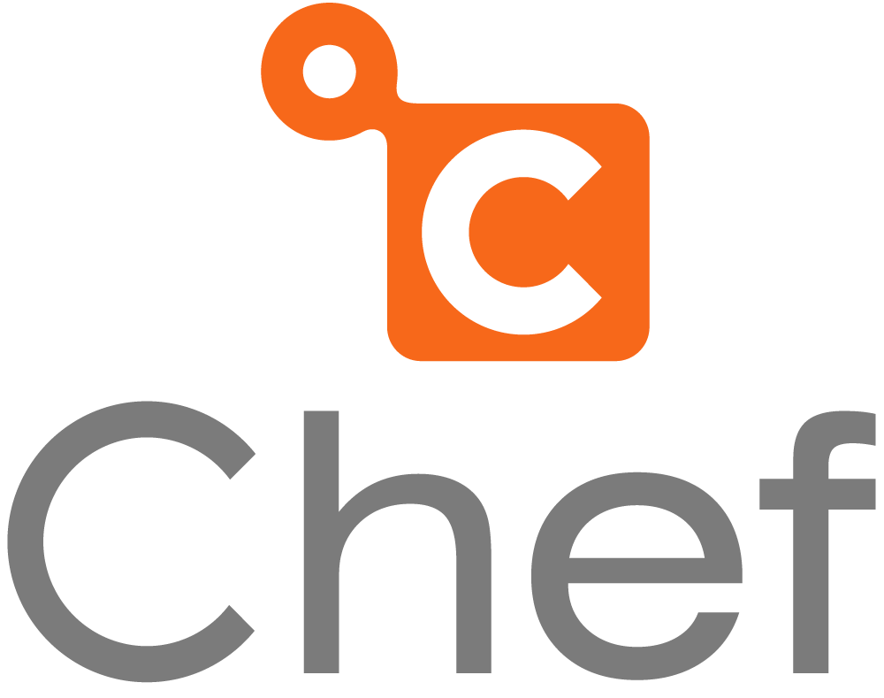
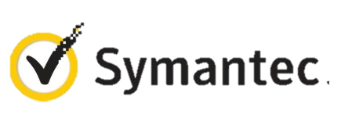

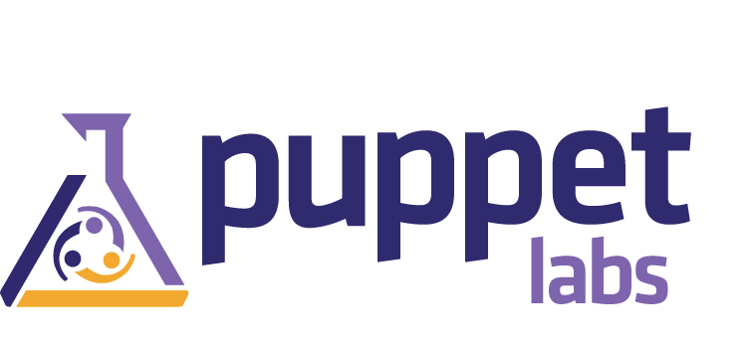
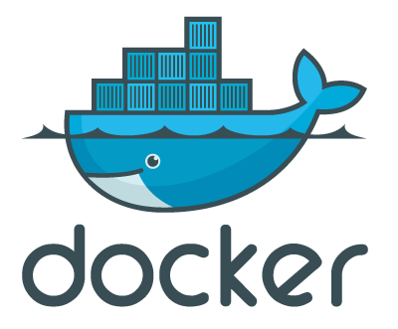

VM Extensions
Small applications that perform post-deployment configuration and automation tasks
Extensions are published by Microsoft & trusted 3rd party publishers
Can be added, updated, disabled, or removed at any time
Managed via Azure Portal, PowerShell, and Management APIs
Notes:
Objective: Discuss the role of VM Extensions in realizing VM instances
Notes:
Extensions are units of code that can be run after the VM has been created to perform additional configuration.
Typical extension functions include software installation, OS configuration
Anti-virus configuration, which may be mandated by Compliance
Custom Script configuration – run a custom script
Chef, Puppet extensions – automated management at scale
Symantec Endpoint protection
Docker
Visual Studio remote Debugger

Slide 13
Scalability & Reliability
Notes:
Objective: This section will discuss the options for scaling VM’s (VM sizes and storage) and also the concepts of reliability via Availability Sets

Slide 14
Choosing a VM Size
High Performance Compute
General Purpose
Compute Optimized
Memory Optimized
GPU
A0 – A5 Basic
F1, F2, F4, F8, F16
D11 – D14
NV6, NV12, NV24
A8 – A11
A0 – A7 Standard
D11v2 – D15v2
NC6, NC12, NC24, NC24r
H8, H8m, H16, H16m, H16r, H16mr
D1 – D4
G1 – G5
D1v2 – D5v2
Notes:
Objective: Illustrate the many different possible VM hardware configurations, slotted by purpose.
Notes:
A key takeaway here is that part of provisioning your VM’s is determining the Family/Size that best addresses your needs.
Information Source: https://azure.microsoft.com/en-us/pricing/details/virtual-machines/linux/
General:
A0 – A4 Basic: 1-8 cores, .75-14 GB RAM. Entry-level, economical. Good for dev workloads, dev/test
A0 – A7 Standard: 1-8 cores, .74-56 GB RAM. Entry-level, economical. Supports load-balancing, auto-scaling. Good for dev workloads, dev/test
D1 – D4 (v1): 1 – 8 cores, 3.5 – 28 GB RAM. More powerful CPU than A, feature SSD’s. Also available in Ds (premium storage
D1v2 – D5vs: 1 – 16 cores, 3.5 – 56 GB RAM. Newer-gen D-series, 35% faster CPU than D.
Compute Optimized:
F1 – F16: 1 – 16 cores, 2 – 32 GB RAM. Higher CPU to memory ratio Good for batch-processing, web servers, analytics, gaming.
Memory Optimized:
D11 – D14 (v1): 2 – 16 cores, 14 – 112 GB RAM. Ideal for memory-intensive enterprise applications.
D11v2 – D15v2: 2 – 20 cores, 14 – 140 GB RAM. Ideal for memory-intensive enterprise applications.
GPU
NV6 - NV24: Good for high-end remote visualization, deep-learning, predictive analytics. V series focuses on visualization.
NC6 - NC24/r: Good for high-end remote visualization, deep-learning, predictive analytics. C series focuses on compute. (24r is for tightly-coupled parallel computing workloads with 2nd low-latency, high-throughput NIC)
HPC
A8 – A11: A8 & A10 have 8 cores & 56 GB RAM, A9 & A11 have 16 cores & 112 GB RAM. Entry-level, economical. Good for dev workloads, dev/test
H8, H16, m&r: 8, 16 cores, 56GB – 224 GB RAM. M = high memory, r = RDMA network. Good for risk modeling, seismic & reservoir simulation, molecular modeling, genomic research.
COMING SOON
L-Series: “Storage optimized”

Slide 15
Disks vs Images
OS Images
Microsoft
Partner
User
Base OS image for new Virtual Machines
Sys-Prepped/Generalized/Read Only
Created by uploading or by capture
Disks
OS Disks
Data Disks
Writable Disks for Virtual Machines
Created during VM creation or during upload of existing VHDs.
Notes:
Objective: To present the difference between an OS Image and a VM Disk
Notes:
Images are reference VHDs (almost like a template) for realizing OS Disks for VMs.
VM’s typically have at least 2 disks:
OS Disk (C on Windows), persistent content. SATA access
Temp Storage (D on Windows), SATA access, NOT PERSISTENT (Temp storage only) (Good for TempDB on SQL images, for example)
Additionally, VM’s can have 0->n (depends on characteristics of VM size chosen) data disks
Drive-letter assigned on Windows, SCSI, Persistent
Can be striped for performance
Limit on # determined by VM family/size

Slide 16
Storage Disks
Standard Storage
Premium Storage
Azure File Storage
Cloud-scale reliable storage
Maximum 500 IOPS, 60 MB per second throughput per disk
Available in all VM Sizes
High-performance, low-latency disk support, ideal for I/O intensive workloads
Maximum 5000 IOPS, 200 MB per second throughput per disk
Only supported in “S” series VMS (DS, DSv2, GS, FS)
Locally redundant storage only
Mount Azure Storage as network share volumes
Can be accessed via SMB 3.0 or REST APIs
Up to 1000 IOPS, up to 60 MB/second throughput per share
Max share size = 5TB, Max file size = 1 TB.
Notes:
Objective: To discuss the available different kinds of storage that can be used by VM disks
Notes:
Data disks have max capacity of 1 TB, but can be striped for larger sizes, up to 64 TB of storage per VM
Azure imposes limits on the number of data disks and amount of bandwidth available, depending on the VM size. (eg F2S = max 4 data disks, F16S = max 32 data disks)
Per-Disk (and Share) IOPS are 8KB operations
Standard Storage
IOPS and Throughput per disk above are for Standard, basic is lower
Entire storage account (not just single disk) has max IOPS of 20,000
Premium Storage
IOPS and Throughput per disk above are for P30, lower for P10, P20
With a GS5, supports up to 80,000 IOPS and 2000 MB/s throughput per VM
Entire storage account has a max total throughput rate of 50 Gbps
No Azure-imposed limit on the number of file shares that can be mounted, no limit on the number of VM’s that can simultaneously mount a File Storage share
Can also be mounted by on-premises clients (Windows) - on prem mounting requires Windows 8 or newer (Server 2012+) and firewall cooperation
No limit on # of files in a share (other than overall share size)

Slide 17
Azure Fault and Update Domains
Fault domains are groupings of VMs that share the same physical hardware (server rack, power connection, network switch.)
Update domains are groupings of VMs that can be rebooted at the same time.
Deploying your VMs into an Availability Set distributes them across Fault & Update Domains in order to help ensure uptime for your system.
Notes:
Objective: To introduce the concepts of Fault & Update domains in the context of discussing reliability
Notes:
For Fault Domains:
Generally hardware-centric
Think “single point of failure”
Note that a Fault Domain can actually span multiple physical racks – you’re not too worried about that, but it just means that items in different Fault Domains are assured to be on different hardware
Update Domains
Update domains are largely related to patching the host OS
A given Fault Domain can host multiple update domains, as long as not ALL update domains are on a given rack.

Slide 18
Availability Sets
Rack
Rack
Rack
Web Servers
INSTANCE 1
INSTANCE 2
INSTANCE 3
FD 0 UD 0
FD 1 UD 1
FD 2 UD 2
INSTANCE 4
INSTANCE 5
INSTANCE 6
FD 0 UD 3
FD 1 UD 4
FD 2 UD 0
INSTANCE 7
INSTANCE 8
INSTANCE 9
FD 0 UD 1
FD 1 UD 2
FD 2 UD 3
INSTANCE 10
FD 0 UD 4
Notes:
Objective: Part of a multiple slide sequence that illustrates the concept of Availability Sets and their relationship to Fault & Update domains
Notes:
Shows how VM’s in an Availability Set are laid out (striped) across FDs & UDs
The animation will show 10 instances striped across racks in a FD, and also increasing US’s from 0-4, then repeating again.

Slide 19
Availability Sets – Rack Failure
Rack
Rack
Rack
Web Servers
INSTANCE 1
INSTANCE 2
INSTANCE 3
FD 0 UD 0
FD 1 UD 1
FD 2 UD 2
INSTANCE 4
INSTANCE 5
INSTANCE 6
FD 0 UD 3
FD 1 UD 4
FD 2 UD 0
INSTANCE 7
INSTANCE 8
INSTANCE 9
FD 0 UD 1
FD 1 UD 2
FD 2 UD 3
INSTANCE 10
FD 0 UD 4
Notes:
Objective: Part of a multiple slide sequence that illustrates the concept of Availability Sets and their relationship to Fault & Update domains
Notes:
Illustrates what happens when a rack goes down
The animation will (partially) show when the rack representing FD0 dies.
When the Azure infrastructure realizes this rack is dead, it will work to stand up the missing VM’s in a new rack (not shown in animation.)

Slide 20
Availability Sets - Maintenance
Rack
Rack
Rack
Web Servers
INSTANCE 1
INSTANCE 2
INSTANCE 3
FD 0 UD 0
FD 1 UD 1
FD 2 UD 2
INSTANCE 4
INSTANCE 5
INSTANCE 6
FD 0 UD 3
FD 1 UD 4
FD 2 UD 0
INSTANCE 7
INSTANCE 8
INSTANCE 9
FD 0 UD 1
FD 1 UD 2
FD 2 UD 3
INSTANCE 10
FD 0 UD 4
Notes:
Objective: Part of a multiple slide sequence that illustrates the concept of Availability Sets and their relationship to Fault & Update domains
Notes:
Illustrates Azure managing downtime when performing scheduled maintenance (such as updating host machines)
The animation will show an update propagating across each FD in turn.
NOTE: Don’t count on update sequence being linear from UD 0 to UD4. It will do 1 UD at a time, but might follow a different sequence.

Slide 21
Knowing Your 9’s
Availability (%) | Description | Downtime (Minutes) |  |  | Practical Meaning | FAA Rating
 |  | Annual | Quarterly | Monthly
90 | Unmanaged | 52,596.00 | 13,149.00 | 4,383.00 | Down 5 weeks per year
99 | Managed | 5,259.60 | 1,314,90 | 438.30 | Down 4 days per year | ROUTINE
99.9 | Well-Managed | 525.96 | 131.49 | 43.83 | Down 9 hours per year | ESSENTIAL
99.99 | Fault-Tolerant | 52.60 | 131.15 | 4.38 | Down 1 hour per year
99.999 | High Availability | 5.26 | 1.31 | .44 | Down 5 minutes per year | CRITICAL
99.9999 | Very High Availability | 0.53 | 0.13 | 0.04 | Down 30 seconds per year
99.99999 | Ultra Availability | 0.05 | 0.01 | -- | Down 3 seconds per year | SAFETY CRITICAL
From Generic Requirements for Operation Systems Platform Reliability, Telcordia Technologies System Documentation,GR-2841-CORE and
Federation Aviation Administration Handbook: Reliability, Maintainability, and Availability (RMA) Handbook, FAA-HDBK-006A, Jan 7, 2008.
Notes:
Objective: To introduce the concept of n-nines and show how it reflects uptime
Notes:
The concept of “n-nines” (three-nines, five nines, etc) is often used as a shorthand to discuss uptime in a system. There’s actually some standard naming around this concept. It’s also interesting to see exactly how many minutes of downtime each tier represents annually, quarterly, or monthly. The final column is the standard naming used by the FAA to describe key “nines” levels.

Slide 22
Azure VM Service Level Agreement
99.95% for multiple role instances in an Availability Set
What’s Included
Computer hardware failure (disk, CPU, memory)
Data Center failures – network, power
Hardware upgrades, software maintenance, Host OS Updates
Not Included
VM Container crashes, Guest OS updates
Notes:
Objective: To present the concept of the Azure VM SLA.
Notes:
Discuss what an SLA is and is *NOT* - these are not always met, and there’s usually some form of compensation. However, the track record is actually pretty good.
This SLA translates to ~4.38 hours of downtime per year
Requires using VM’s that have 2 or more instances deployed in the same Availability Set, and measures/assures connectivity to at least one instance
Source: https://azure.microsoft.com/en-us/support/legal/sla/virtual-machines/v1_2/

Slide 23
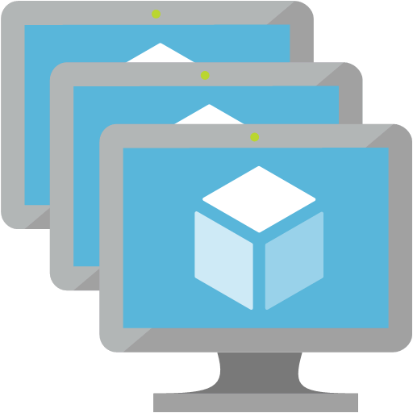
VM Scale Sets
Easily deploy a set of VMs based on the same image
Implicitly balanced across Fault & Update Domains
VM Scale sets are implicitly an Availability Set (3 FD, 5 UD)
Manual or rule-based scaling for the Scale Set capacity
Use a Load Balancer or Application Gateway to distribute requests across the available VM’s in a Scale Set
Notes:
Objectives: To present the concept of VM Scale Sets (VMSS’s)
Notes:
Ideal for clusters/farms (cattle, not pets)
Without VMSS, you have to manage scaling of VM’s with pre-provisioned images (bring online, stop as needed)
Currently do *NOT* support data disks, but can mount Azure Storage File Shares (data drives in-preview, coming soon)
The auto-scaling infrastructure even works with WebHooks, allowing you to receive notifications when scaling operations happen.

Slide 24
Networking
Notes:
Objective: This section will discuss the tooling available for managing the networking configuration of VMs in Azure

Slide 25
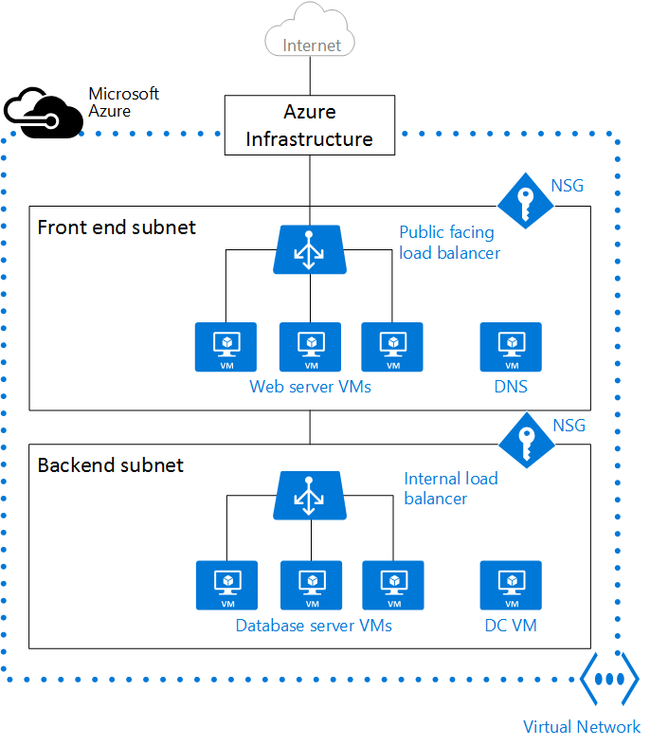
Virtual Networks
“Bring your own network”
Provides security and isolation by creating a private network inside of Azure
Supports:
Defining subnets
“Peering” with other non-overlapping VNETs in the same region
Defining Network Security Groups (ACL rules)
Allows you to create complex and/or sophisticated network topologies around your VM’s
Notes:
Objective: To introduce the concept of Virtual Networks (VNETs) in Azure
Notes:
A VNET is “your private network within the overall Azure network”
Along with the VNET, you can leverage other tools like Load Balancers, Network Service Gateways, Application Gateways, Public IP Addresses, etc.
Peering (new feature) allows 2 VNETs to be maintained as separate resources, but VMs in those VNETs can communicate with each other directly via IP Address.
VNETs can define Network Security Groups, which contain ACL rules that allow or deny traffic to VM instances in a VNET.
NSG’s can be associated with subnets or individual VM instances
Illustration source: https://azure.microsoft.com/en-us/documentation/articles/virtual-networks-overview/

Slide 26

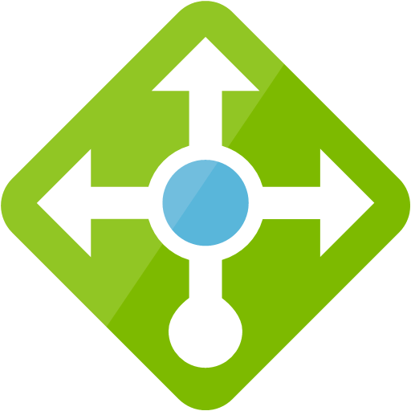


Other Network Resources
Reserved Public IP Addresses
Internal or External Load Balancers
Application Gateways
Application Gateway Web Application Firewall (Preview)
Notes:
Objective: To introduce some other Azure Networking resources that often complement VNETs.
Notes:
Reserved Public IP Addresses
Can be dynamic or reserved IP addresses
Load balancers act as a NAT
Public IP address can be associated to it (public), private is assigned an address in the subnet (and is accessed via that address)
Private load balancers are usually found in multi-tier apps/deployments, where only one (front) tier is internet-facing.
Also, with VPNs, the ILB can ensure company resource are only available internally to other systems on the same VNET
Supports hashed distribution of traffic, as well as port forwarding, auto-reconfiguration (scaling), service monitoring (probes), source NAT
Application Gateways
Work at application layer compared to Load Balancer working at the transport layer (Layer 7 vs Layer 4)
Acts as a reverse-proxy…client connections are terminated and requests are then forwarded to back-end endpoints.
HTTP & HTTPS only
Differ from Load Balancer in that this is URL/content-based routing & load balancing
Web Application Firewall (recently announced/in preview)
Preconfigured to prevent OWASP core top 10 vulnerabilities
Custom rules coming soon
You can also stand up a virtual appliance – dedicated VM running 3rd party SW that provides layer-7 security (NSG is layer-4)

Slide 27

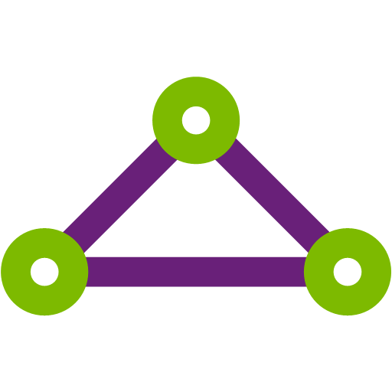
Connecting to On-Premises Networks
Azure VPN Gateway
Connects your on-prem resources to Azure
Includes Point-to-Site and Site-to-Site connections
Can also be used to connect multiple VNETs in Azure
ExpressRoute
Create private connections between Azure datacenters and on-premises or partner/colocation host environments
Connections do *not* go over the public Internet.
Connectivity is faster, more reliable, and more secure than Internet-based connections.
Notes:
Objective: To introduce the networking options in Azure for extending connectivity of a VNET into your on –premises or other networks
Notes:
VPN Gateway – whereas Peering only allows non-overlapping VNET connection in same Region, VPN Gateway allows connections that span regions and even subscriptions (even different deployment models)
Point-to-Site VPN
Allows creating a secure connection to your VNET from an individual computer.
Cert-based
Used primarily for dev/test, small-scale deployments
Does not require dedicated VPN device, run software from the client computer
Connect to network from home/hotel
Can be used with S2S connections through the same VPN Gateway
Site-to-Site VPN
IPSec VPN tunnel connection
Requires a dedicated VPN device on-premises with a public IP address
ExpressRoute
Direct connection to the Azure networking infrastructure
Speed, security (avoids the public internet)
Azure Point-to-Site & Site-to-Site VPN
P2S is VPN Client to server connectivity, certificate-based connectivity
S2S
Network-to-network connectivity
VPN on premises (VPN appliance using IPSec)/leveraging appliance
P2S is limited to ~128 concurrent connections, no infrastructure
S2S – need infrastructure (software-based appliances, or true hardware appliances)
Private WAN connectivity with ExpressRoute
S2S & P2S go over the Internet
ExpressRoute goes direct – not over Internet
ExpressRoute is not limited to VNet access (can connect to all Azure services)
VPN gateway – connect VNETs either with or across regions
ExpressRoute – Leverage a high-throughput private Fiber connection to an Azure Data Center

Slide 28
Additional Concepts
Notes:
Objective: This section will present additional solutions built on top of the Azure VM infrastructure (namely, DevTest labs)

Slide 29
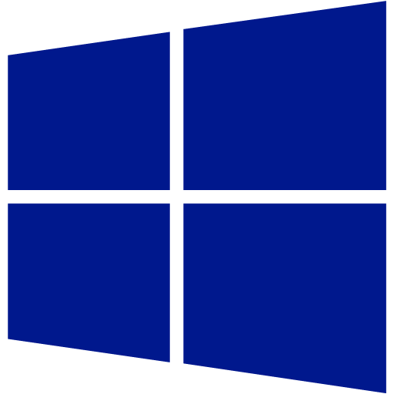



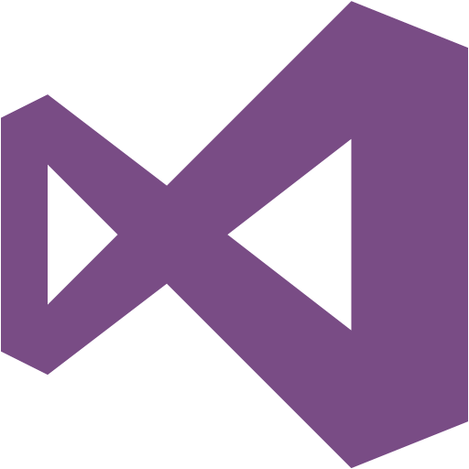


Azure DevTest Labs
Manage a set of VM’s or provide worry-free self-service for dev-test lab environments.
Use “Formulas” to create reusable VM configurations
Use “Artifacts” to create reusable VM configuration elements
Configure policies for auto-shutdown, auto-start
Role-based access for Owners, Contributors, Lab Users
Notes:
Objective: To discuss Azure DevTest Labs as an extension or a solution that builds on VM’s/IaaS
Notes:
Designed to allow dev-test lab setup, access, and management scenarios, but can be applied for other uses (classroom, etc.)
VM “Formulas” allow you to select pre-existing or custom base images and size/configurations, as well as “artifacts to be applied to those images
Artifacts are useful for pre-installing SW or running config scripts
Install Chrome or Firefox browsers
Install Git and retrieve a project from a repository
Install VS Code, PowerShell, NodeJS, or other development & runtime tools
Install Chocolatey / Apt-Get packages
Run startup scripts (PowerShell (both Windows or Linux) or Bash (Linux))
Auto-shutdown: includes optional Webhook-based pre-shutdown notifications
Auto-start: choose days of the week where this should apply (do not auto-start on weekends)
Other – limit the available VM Marketplace images, VM sizes, Limit the available # of VM’s per user
RBAC – Owners and Contributors can do everything, except contributors cannot add new users to the lab. Regular “users” can create new VM (instances) and formulas, and manage their own created VM instances (including applying artifacts), but cannot do much else.

